Slide 1
Prepare for Snowboarding Season
Vertical Slope Shop Long Nguyen, Owner

Slide 2

Dress for the Ride
Loose fitting layers
Moisture wicking inner
Insulating middle
Water proof outer shell
Goggles
Helmet, wrist guards

Slide 3
Get into Condition
Stretch for 10 minutes
Do lateral squats, hops
Eat complex carbohydrates
Drink plenty of water
Dehydration is common

Slide 4
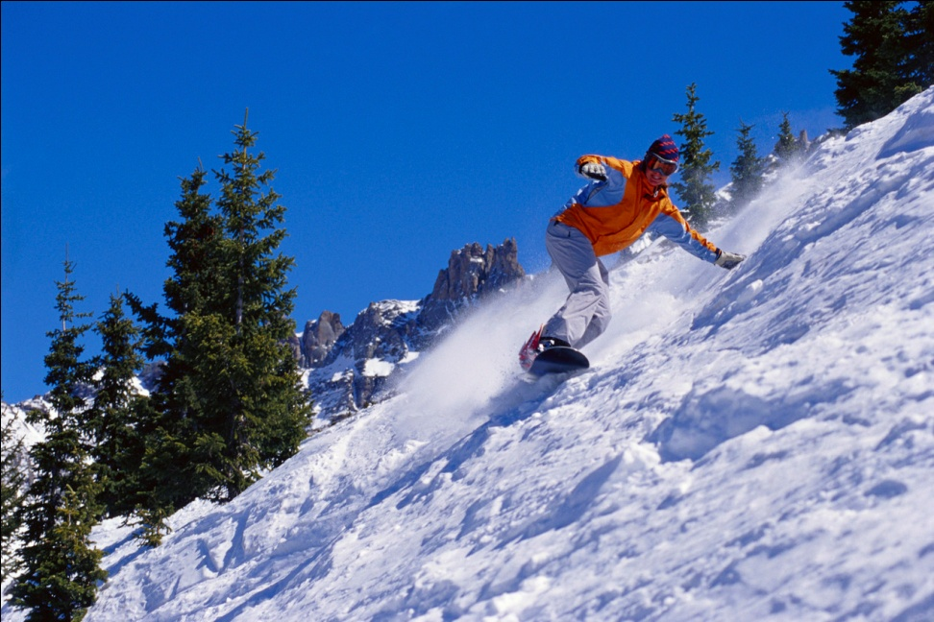
Snowboard under control
Be aware of traffic
Where trails merge
Stick to slopes designed for your ability
Be aware of changing conditions

